Slide 1
Sports Hub
Buy tickets for different sports events
CSP-584
Team No. 33
Amitdeb Bhattacharya A20402789
Baltej Singh A20444488

Slide 2
Description:
Allows customer to register and login to purchase tickets online for sports event.
Customer can also purchase tickets for different locations.
Customer can see upcoming schedule for the games.
Sends e-ticket by email to customer after successful purchase of ticket.
Allows customer to view purchase history.

Slide 3
Technologies:
HTML
CSS
JavaScript
Java
Ajax
MySql
MongoDB
API used:
StubHub API

Slide 4
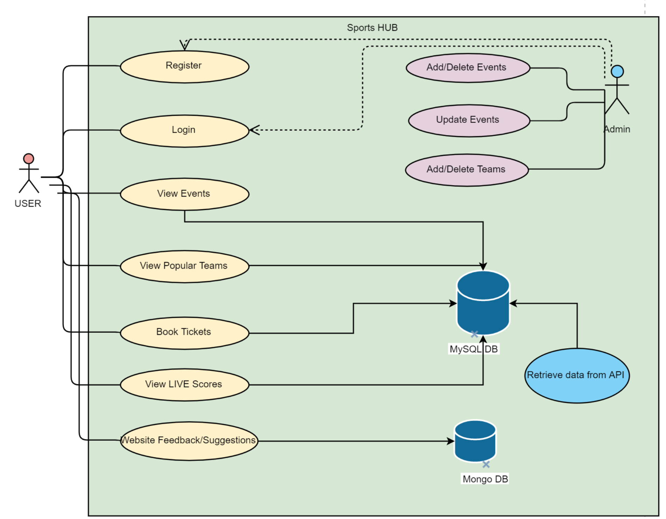

Slide 5
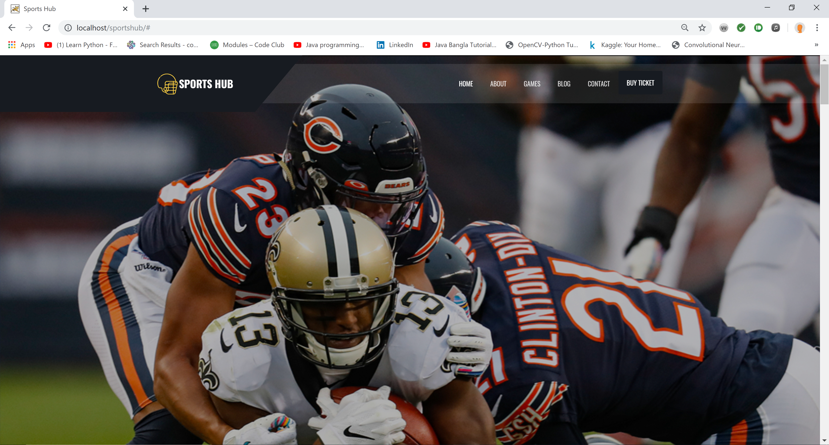

Slide 6
Questions ?

